Slide 1
Association Rules Outline
Goal: Provide an overview of basic Association Rule mining techniques
Association Rules Problem Overview
  Large itemsets
Association Rules Algorithms
  Apriori
  Eclat

Slide 2
Example: Market Basket Data
Items frequently purchased together:
  Bread ⇒PeanutButter
Uses:
  Placement
  Advertising
  Sales
  Coupons
Objective: increase sales and reduce costs

Slide 3
Association Rule Definitions
Set of items: I={I₁,I₂,…,I_{m}}
Transactions: D={t₁,t₂, …, t_{n}}, t_{j}⊆ I
Itemset: {I_{i1},I_{i2}, …, I_{ik}} ⊆ I
Support of an itemset: Percentage of transactions which contain that itemset.
Large (Frequent) itemset: Itemset whose number of occurrences is above a threshold.

Slide 4
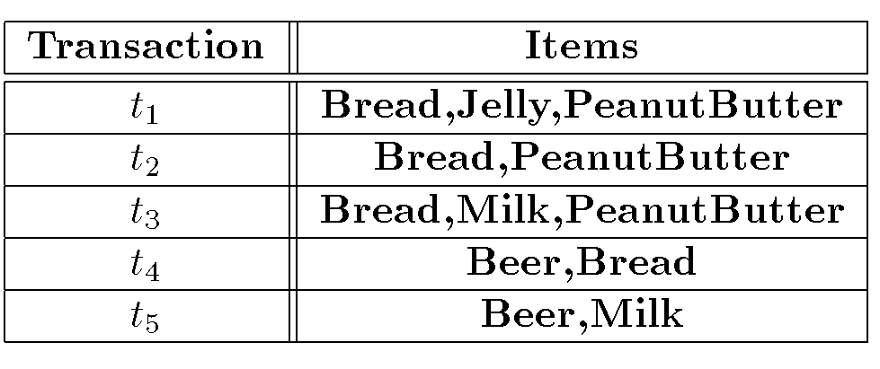
Association Rules Example
I = { Beer, Bread, Jelly, Milk, PeanutButter}
Support of {Bread,PeanutButter} is 60%

Slide 5
Association Rule Definitions
Association Rule (AR): implication X ⇒ Y where X,Y ⊆ I and X ∩ Y = ;
Support of AR (s) X ⇒ Y: Percentage of transactions that contain X ∪Y
Confidence of AR (α) X ⇒ Y: Ratio of number of transactions that contain X ∪ Y to the number that contain X

Slide 6
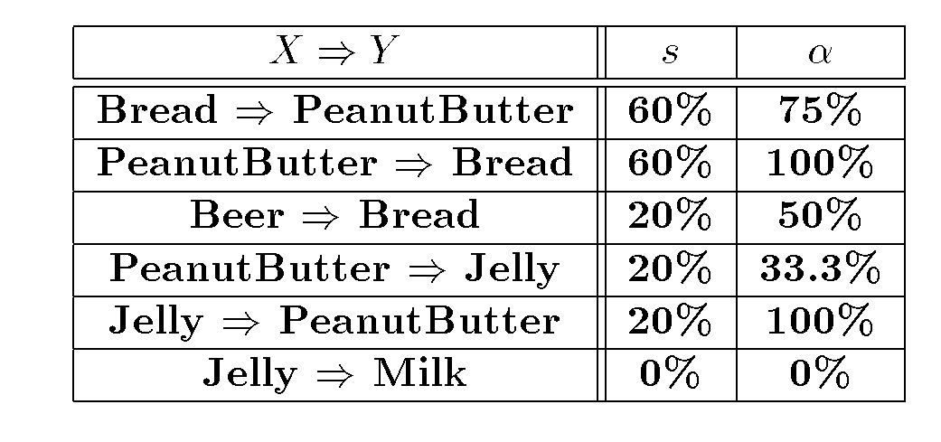
Association Rules Ex (cont’d)

Slide 7
Association Rule Problem
Given a set of items I={I₁,I₂,…,I_{m}} and a database of transactions D={t₁,t₂, …, t_{n}} where t_{i}={I_{i1},I_{i2}, …, I_{ik}} and I_{ij} ∈ I, the Association Rule Problem is to identify all association rules X ⇒ Y with a minimum support and confidence.
Link Analysis
NOTE: Support of X ⇒ Y is same as support of X ∪ Y.

Slide 8
Association Rule Techniques
Find Large Itemsets.
Generate rules from frequent itemsets.

Slide 9
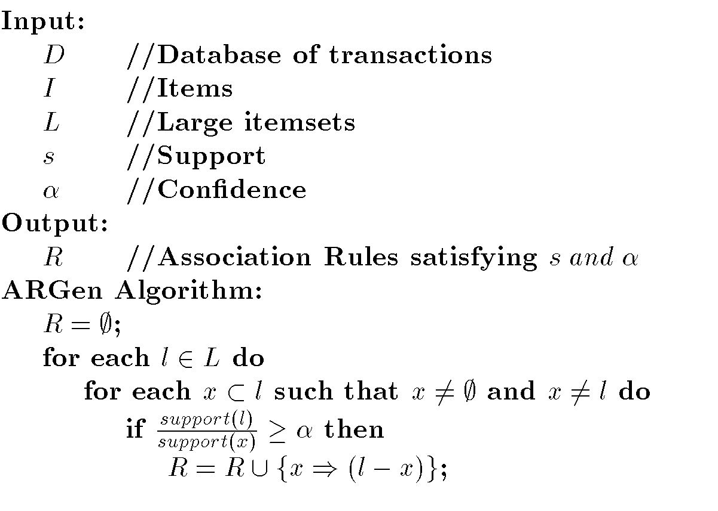
Algorithm to Generate ARs

Slide 10
Apriori
Large Itemset Property:
Any subset of a large itemset is large.
Contrapositive:
If an itemset is not large,
none of its supersets are large.

Slide 11
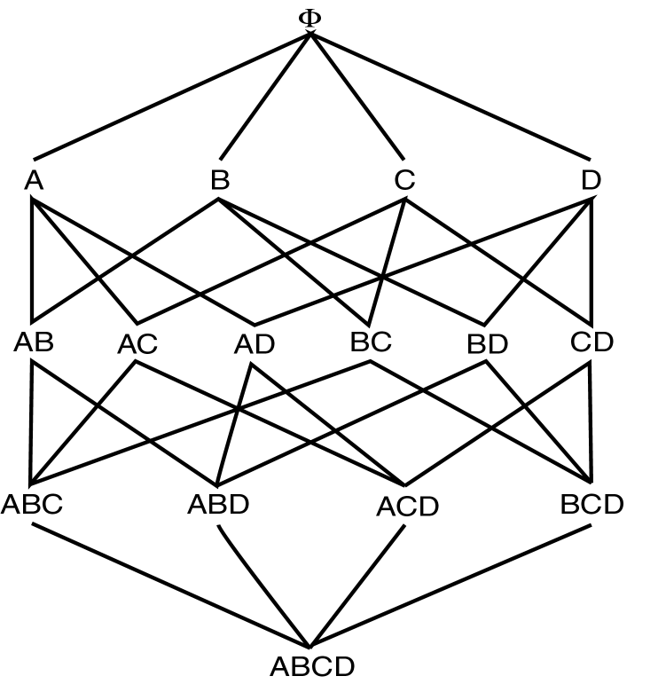
Large Itemset Property

Slide 12
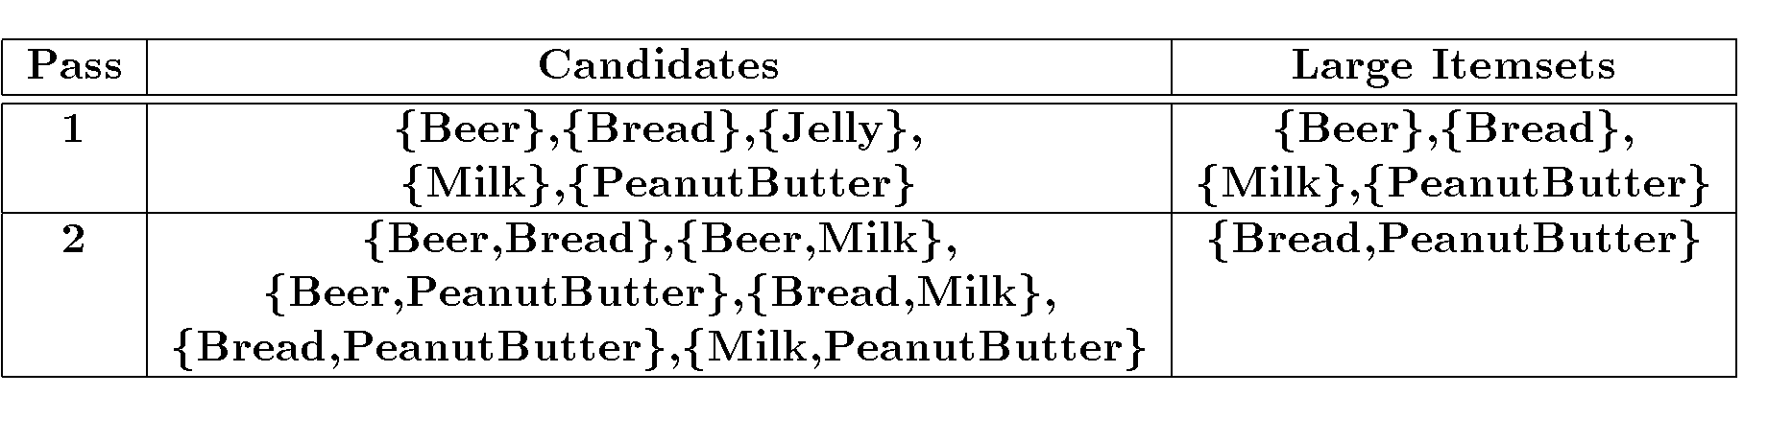
Apriori Ex (cont’d)
s=30% α = 50%

Slide 13
Apriori Algorithm
C₁ = Itemsets of size one in I;
Determine all large itemsets of size 1, L_{1;}
i = 1;
Repeat
i = i + 1;
C_{i} = Apriori-Gen(L_{i-1});
Count C_{i} to determine L_{i;}
until no more large itemsets found;

Slide 14
Apriori-Gen
Generate candidates of size i+1 from large itemsets of size i.
Approach used: join large itemsets of size i if they agree on i-1
May also prune candidates who have subsets that are not large.

Slide 15
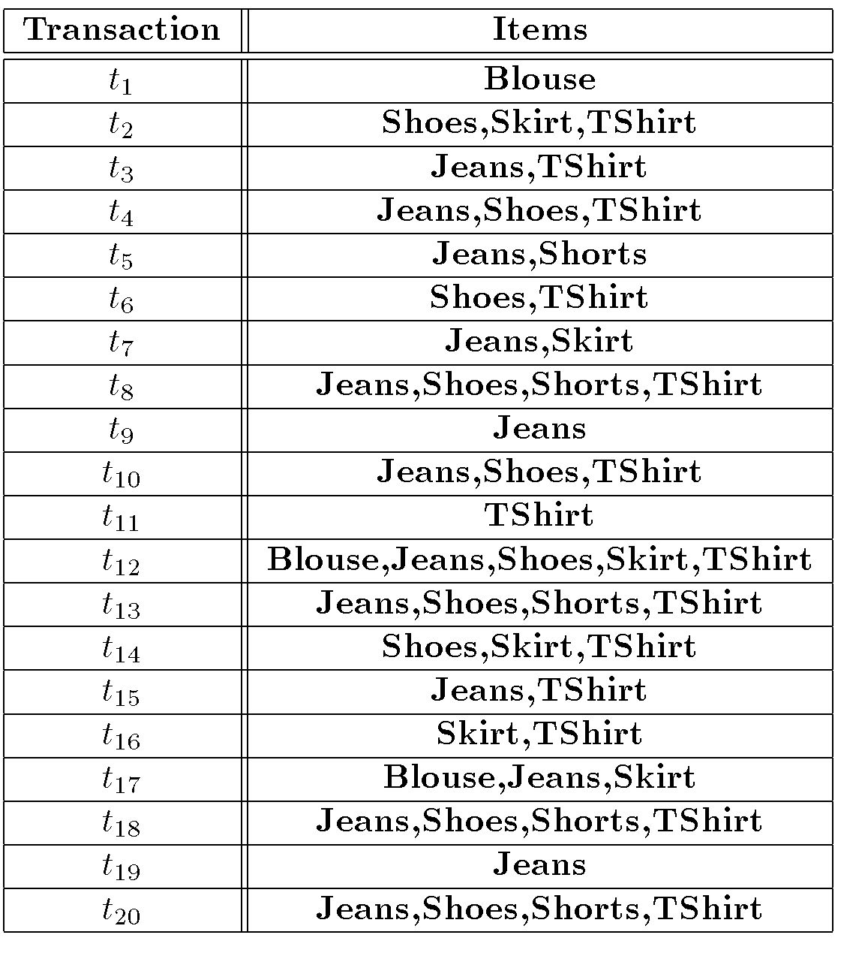
Apriori-Gen Example

Slide 16
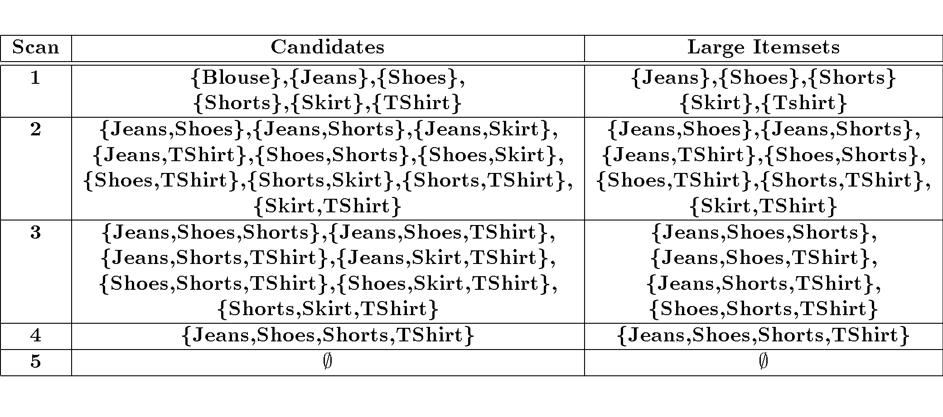
Apriori-Gen Example (cont’d)

Slide 17
Apriori Adv/Disadv
Advantages:
  Uses large itemset property.
  Easily parallelized
  Easy to implement.
Disadvantages:
  Assumes transaction database is memory resident.
  Requires up to m database scans.

Slide 18
Classification based on Association Rules (CBA)
Why?
  Can effectively uncover the correlation structure in data
  AR are typically quite scalable in practice
  Rules are often very intuitive
    Hence classifier built on intuitive rules is easier to interpret
When to use?
  On large dynamic datasets where class labels are available and the correlation structure is unknown.
  Multi-class categorization problems
  E.g. Web/Text Categorization, Network Intrusion Detection

Slide 19
Example: Text categorization
Input
  <feature vector> <class label(s)>
  <feature vector> = w1,…,wN
  <class label(s)> = c1,…,cM
Run AR with minsup and minconf
  Prune rules of form
    w1 → w2, [w1,c2] → c3 etc.
  Keep only rules satisfying the constraing
    W → C (LHS only composed of w1,…wN and RHS only composed of c1,…cM)

Slide 20
CBA: Text Categorization (cont.)
Order remaining rules
  By confidence
    100%
      R1: W1 → C1 (support 40%)
      R2: W4 → C2 (support 60%)
    95%
      R3: W3 → C2 (support 30%)
      R4: W5 → C4 (support 70%)
  And within each confidence level by support
    Ordering R2, R1, R4, R3

Slide 21
CBA: contd
Take training data and evaluate the predictive ability of each rule, prune away rules that are subsumed by superior rules
  T1: W1 W5 C1,C4
  T2: W2 W4 C2 Note: only subset
  T3: W3 W4 C2 of transactions
  T4: W5 W8 C4 in training data
  T5: W9 C2
    Rule R3 would be pruned in this example if it is always subsumed by Rule R2
For remaining transactions pick most dominant class as default
  T5 is not covered, so C2 is picked in this example

Slide 22
Formal Concepts of Model
Given two rules r_{i} and r_{j}, define: r_{i}  r_{j} if
    The confidence of r_{i} is greater than that of r_{j}, or
    Their confidences are the same, but the support of r_{i} is greater than that of r_{j}, or
    Both the confidences and supports are the same, but r_{i} is generated earlier than r_{j}.
Our classifier model is of the following format:
  <r₁, r₂, …, r_{n}, default_class>,
  where r_{i}∈ R, r_{a}  r_{b} if b>a
Other models possible
  Sort by length of antecedent

Slide 23
Using the CBA model to classify
For a new transaction
  W1, W3, W5
  Pick the k-most confident rules that apply (using the precedence ordering established in the baseline model)
  The resulting classes are the predictions for this transaction
    If k = 1 you would pick C1
    If k = 2 you would pick C1, C2 (multi-class)
  Similarly if W9, W10 you would pick C2 (default)
  Accuracy measurements as before (Classification Error)

Slide 24
CBA: Procedural Steps
Preprocessing, Training and Testing data split
Compute AR on Training data
  Keep only rules of form X→ C
    C is class label itemset and X is feature itemset
Order AR
  According to confidence
  According to support (at each confidence level)
Prune away rules that lack sufficient predictive ability on Training data (starting top-down)
  Rule subsumption
For data that is not predictable pick most dominant class as default class
Test on testing data and report accuracy

Slide 25
Association Rules: Advanced Topics

Slide 26
Apriori Adv/Disadv
Advantages:
  Uses large itemset property.
  Easily parallelized
  Easy to implement.
Disadvantages:
  Assumes transaction database is memory resident.
  Requires up to m database scans.

Slide 27
Vertical Layout
Rather than have
  Transaction ID – list of items (Transactional)
We have
  Item – List of transactions (TID-list)
Now to count itemset AB
  Intersect TID-list of itemA with TID-list of itemB
All data for a particular item is available

Slide 28
Eclat Algorithm
Dynamically process each transaction online maintaining 2-itemset counts.
Transform
  Partition L2 using 1-item prefix
    Equivalence classes - {AB, AC, AD}, {BC, BD}, {CD}
  Transform database to vertical form
Asynchronous Phase
  For each equivalence class E
    Compute frequent (E)

Slide 29
Asynchronous Phase
Compute Frequent (E_k-1)
  For all itemsets I1 and I2 in E_k-1
    If (I1 ∩ I2 >= minsup) add I1 and I2 to L_k
  Partition L_k into equivalence classes
  For each equivalence class E_k in L_k
    Compute_frequent (E_k)
Properties of ECLAT
  Locality enhancing approach
  Easy and efficient to parallelize
  Few scans of database (best case 2)

Slide 30
Max-patterns
Frequent pattern {a₁, …, a₁₀₀} → (₁₀₀¹) + (₁₀₀²) + … + (₁¹₀⁰₀⁰) = 2¹⁰⁰-1 = 1.27*10³⁰ frequent sub-patterns!
Max-pattern: frequent patterns without proper frequent super pattern
  BCDE, ACD are max-patterns
  BCD is not a max-pattern
Tid | Items
10 | A,B,C,D,E
20 | B,C,D,E,
30 | A,C,D,F
Min_sup=2

Slide 31
Frequent Closed Patterns
Conf(ac→d)=100% ➔ record acd only
For frequent itemset X, if there exists no item y s.t. every transaction containing X also contains y, then X is a frequent closed pattern
  “acd” is a frequent closed pattern
Concise rep. of freq pats
Reduce # of patterns and rules
N. Pasquier et al. In ICDT’99
Min_sup=2
TID | Items
10 | a, c, d, e, f
20 | a, b, e
30 | c, e, f
40 | a, c, d, f
50 | c, e, f

Slide 32
Mining Various Kinds of Rules or Regularities
Multi-level, quantitative association rules, correlation and causality, ratio rules, sequential patterns, emerging patterns, temporal associations, partial periodicity
Classification, clustering, iceberg cubes, etc.

Slide 33
Multiple-level Association Rules
Items often form hierarchy
Flexible support settings: Items at the lower level are expected to have lower support.
Transaction database can be encoded based on dimensions and levels
explore shared multi-level mining
uniform support
reduced support
Level 1
min_sup = 5%
Milk
[support = 10%]
Level 1
min_sup = 5%
Level 2
min_sup = 5%
2% Milk
[support = 6%]
Skim Milk
[support = 4%]
Level 2
min_sup = 3%

Slide 34
ML/MD Associations with Flexible Support Constraints
Why flexible support constraints?
  Real life occurrence frequencies vary greatly
    Diamond, watch, pens in a shopping basket
  Uniform support may not be an interesting model
A flexible model
  The lower-level, the more dimension combination, and the long pattern length, usually the smaller support
  General rules should be easy to specify and understand
  Special items and special group of items may be specified individually and have higher priority

Slide 35
Multi-dimensional Association
Single-dimensional rules:
    buys(X, “milk”) ⇒ buys(X, “bread”)
Multi-dimensional rules: ≥ 2 dimensions or predicates
  Inter-dimension assoc. rules (no repeated predicates)
    age(X,”19-25”) ∧ occupation(X,“student”) ⇒ buys(X,“coke”)
  hybrid-dimension assoc. rules (repeated predicates)
    age(X,”19-25”) ∧ buys(X, “popcorn”) ⇒ buys(X, “coke”)

Slide 36
Multi-level Association: Redundancy Filtering
Some rules may be redundant due to “ancestor” relationships between items.
Example
  milk ⇒ wheat bread [support = 8%, confidence = 70%]
  2% milk ⇒ wheat bread [support = 2%, confidence = 72%]
We say the first rule is an ancestor of the second rule.
A rule is redundant if its support is close to the “expected” value, based on the rule’s ancestor.

Slide 37
Multi-Level Mining: Progressive Deepening
A top-down, progressive deepening approach:
  First mine high-level frequent items:
milk (15%), bread (10%)
  Then mine their lower-level “weaker” frequent itemsets:
2% milk (5%), wheat bread (4%)
Different min_support threshold across multi-levels lead to different algorithms:
  If adopting the same min_support across multi-levels
    then toss t if any of t’s ancestors is infrequent.
  If adopting reduced min_support at lower levels
    then examine only those descendents whose ancestor’s support is frequent/non-negligible.

Slide 38
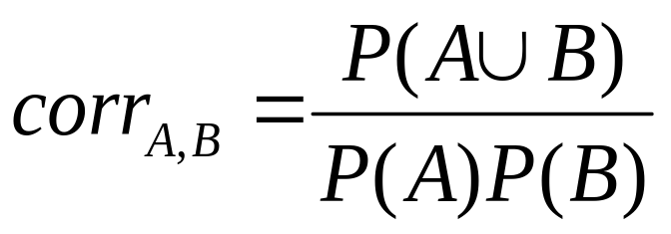
Interestingness Measure: Correlations (Lift)
play basketball ⇒ eat cereal [40%, 66.7%] is misleading
  The overall percentage of students eating cereal is 75% which is higher than 66.7%.
play basketball ⇒ not eat cereal [20%, 33.3%] is more accurate, although with lower support and confidence
Measure of dependent/correlated events: lift
 | Basketball | Not basketball | Sum (row)
Cereal | 2000 | 1750 | 3750
Not cereal | 1000 | 250 | 1250
Sum(col.) | 3000 | 2000 | 5000

Slide 39
Constraint-based Data Mining
Finding all the patterns in a database autonomously? — unrealistic!
  The patterns could be too many but not focused!
Data mining should be an interactive process
  User directs what to be mined using a data mining query language (or a graphical user interface)
Constraint-based mining
  User flexibility: provides constraints on what to be mined
  System optimization: explores such constraints for efficient mining—constraint-based mining

Slide 40
Constrained Frequent Pattern Mining: A Mining Query Optimization Problem
Given a frequent pattern mining query with a set of constraints C, the algorithm should be
  sound: it only finds frequent sets that satisfy the given constraints C
  complete: all frequent sets satisfying the given constraints C are found
A naïve solution
  First find all frequent sets, and then test them for constraint satisfaction
More efficient approaches:
  Analyze the properties of constraints comprehensively
  Push them as deeply as possible inside the frequent pattern computation.

Slide 41
Anti-Monotonicity in Constraint-Based Mining
TDB (min_sup=2)
Anti-monotonicity
  When an intemset S violates the constraint, so does any of its superset
  sum(S.Price) ≤ v is anti-monotone
  sum(S.Price) ≥ v is not anti-monotone
Example. C: range(S.profit) ≤ 15 is anti-monotone
  Itemset ab violates C
  So does every superset of ab
TID | Transaction
10 | a, b, c, d, f
20 | b, c, d, f, g, h
30 | a, c, d, e, f
40 | c, e, f, g
Item | Profit
a | 40
b | 0
c | -20
d | 10
e | -30
f | 30
g | 20
h | -10

Slide 42
Which Constraints Are Anti-Monotone?
Constraint | Antimonotone
v ∈ S | No
S ⊇ V | no
S ⊆ V | yes
min(S) ≤ v | no
min(S) ≥ v | yes
max(S) ≤ v | yes
max(S) ≥ v | no
count(S) ≤ v | yes
count(S) ≥ v | no
sum(S) ≤ v ( a ∈ S, a ≥ 0 ) | yes
sum(S) ≥ v ( a ∈ S, a ≥ 0 ) | no
range(S) ≤ v | yes
range(S) ≥ v | no
avg(S) θ v, θ ∈ { =, ≤, ≥ } | convertible
support(S) ≥ ξ | yes
support(S) ≤ ξ | no

Slide 43
Monotonicity in Constraint-Based Mining
TDB (min_sup=2)
Monotonicity
  When an intemset S satisfies the constraint, so does any of its superset
  sum(S.Price) ≥ v is monotone
  min(S.Price) ≤ v is monotone
Example. C: range(S.profit) ≥ 15
  Itemset ab satisfies C
  So does every superset of ab
TID | Transaction
10 | a, b, c, d, f
20 | b, c, d, f, g, h
30 | a, c, d, e, f
40 | c, e, f, g
Item | Profit
a | 40
b | 0
c | -20
d | 10
e | -30
f | 30
g | 20
h | -10

Slide 44
Which Constraints Are Monotone?
Constraint | Monotone
v ∈ S | yes
S ⊇ V | yes
S ⊆ V | no
min(S) ≤ v | yes
min(S) ≥ v | no
max(S) ≤ v | no
max(S) ≥ v | yes
count(S) ≤ v | no
count(S) ≥ v | yes
sum(S) ≤ v ( a ∈ S, a ≥ 0 ) | no
sum(S) ≥ v ( a ∈ S, a ≥ 0 ) | yes
range(S) ≤ v | no
range(S) ≥ v | yes
avg(S) θ v, θ ∈ { =, ≤, ≥ } | convertible
support(S) ≥ ξ | no
support(S) ≤ ξ | yes

Slide 45
Succinctness
Succinctness:
  Given A_{1,} the set of items satisfying a succinctness constraint C, then any set S satisfying C is based on A₁ , i.e., S contains a subset belonging to A₁
  Idea: Without looking at the transaction database, whether an itemset S satisfies constraint C can be determined based on the selection of items
  min(S.Price) ≤ v is succinct
  sum(S.Price) ≥ v is not succinct
Optimization: If C is succinct, C is pre-counting pushable

Slide 46
Which Constraints Are Succinct?
Constraint | Succinct
v ∈ S | yes
S ⊇ V | yes
S ⊆ V | yes
min(S) ≤ v | yes
min(S) ≥ v | yes
max(S) ≤ v | yes
max(S) ≥ v | yes
sum(S) ≤ v ( a ∈ S, a ≥ 0 ) | no
sum(S) ≥ v ( a ∈ S, a ≥ 0 ) | no
range(S) ≤ v | no
range(S) ≥ v | no
avg(S) θ v, θ ∈ { =, ≤, ≥ } | no
support(S) ≥ ξ | no
support(S) ≤ ξ | no

Slide 47








The Apriori Algorithm — Example
Database D
L₁
C₁
Scan D
C₂
C₂
L₂
Scan D
C₃
Scan D
L₃

Slide 48
Naïve Algorithm: Apriori + Constraint
Database D
L₁
C₁
Scan D
C₂
C₂
L₂
Scan D
C₃
Scan D
L₃
Constraint:
Sum{S.price < 5}

Slide 49
Pushing the constraint deep into the process
Database D
L₁
C₁
Scan D
C₂
C₂
L₂
Scan D
C₃
Scan D
L₃
Constraint:
Sum{S.price < 5}

Slide 50
Push a Succinct Constraint Deep
Database D
L₁
C₁
Scan D
C₂
C₂
L₂
Scan D
C₃
Scan D
L₃
Constraint:
min{S.price <= 1 }

Slide 51
Converting “Tough” Constraints
TDB (min_sup=2)
TID | Transaction
10 | a, b, c, d, f
20 | b, c, d, f, g, h
30 | a, c, d, e, f
40 | c, e, f, g
Convert tough constraints into anti-monotone or monotone by properly ordering items
Examine C: avg(S.profit) ≥ 25
  Order items in value-descending order
    <a, f, g, d, b, h, c, e>
  If an itemset afb violates C
    So does afbh, afb*
    It becomes anti-monotone!
Item | Profit
a | 40
b | 0
c | -20
d | 10
e | -30
f | 30
g | 20
h | -10

Slide 52
Convertible Constraints
Let R be an order of items
Convertible anti-monotone
  If an itemset S violates a constraint C, so does every itemset having S as a prefix w.r.t. R
  Ex. avg(S) ≤ v w.r.t. item value descending order
Convertible monotone
  If an itemset S satisfies constraint C, so does every itemset having S as a prefix w.r.t. R
  Ex. avg(S) ≥ v w.r.t. item value descending order

Slide 53
Strongly Convertible Constraints
avg(X) ≥ 25 is convertible anti-monotone w.r.t. item value descending order R: <a, f, g, d, b, h, c, e>
  If an itemset af violates a constraint C, so does every itemset with af as prefix, such as afd
avg(X) ≥ 25 is convertible monotone w.r.t. item value ascending order R⁻¹: <e, c, h, b, d, g, f, a>
  If an itemset d satisfies a constraint C, so does itemsets df and dfa, which having d as a prefix
Thus, avg(X) ≥ 25 is strongly convertible
Item | Profit
a | 40
b | 0
c | -20
d | 10
e | -30
f | 30
g | 20
h | -10

Slide 54
What Constraints Are Convertible?
Constraint | Convertible anti-monotone | Convertible monotone | Strongly convertible
avg(S) ≤ , ≥ v | Yes | Yes | Yes
median(S) ≤ , ≥ v | Yes | Yes | Yes
sum(S) ≤ v (items could be of any value, v ≥ 0) | Yes | No | No
sum(S) ≤ v (items could be of any value, v ≤ 0) | No | Yes | No
sum(S) ≥ v (items could be of any value, v ≥ 0) | No | Yes | No
sum(S) ≥ v (items could be of any value, v ≤ 0) | Yes | No | No
……

Slide 55
Combing Them Together—A General Picture
Constraint | Antimonotone | Monotone | Succinct
v ∈ S | no | yes | yes
S ⊇ V | no | yes | yes
S ⊆ V | yes | no | yes
min(S) ≤ v | no | yes | yes
min(S) ≥ v | yes | no | yes
max(S) ≤ v | yes | no | yes
max(S) ≥ v | no | yes | yes
count(S) ≤ v | yes | no | weakly
count(S) ≥ v | no | yes | weakly
sum(S) ≤ v ( a ∈ S, a ≥ 0 ) | yes | no | no
sum(S) ≥ v ( a ∈ S, a ≥ 0 ) | no | yes | no
range(S) ≤ v | yes | no | no
range(S) ≥ v | no | yes | no
avg(S) θ v, θ ∈ { =, ≤, ≥ } | convertible | convertible | no
support(S) ≥ ξ | yes | no | no
support(S) ≤ ξ | no | yes | no

Slide 56
Classification of Constraints
Monotone
Antimonotone
Strongly
convertible
Succinct
Convertible
anti-monotone
Convertible
monotone
Inconvertible

Slide 57
Mining With Convertible Constraints
TDB (min_sup=2)
TID | Transaction
10 | a, f, d, b, c
20 | f, g, d, b, c
30 | a, f, d, c, e
40 | f, g, h, c, e
C: avg(S.profit) ≥ 25
List of items in every transaction in value descending order R:
  <a, f, g, d, b, h, c, e>
  C is convertible anti-monotone w.r.t. R
Scan transaction DB once
  remove infrequent items
    Item h in transaction 40 is dropped
  Itemsets a and f are good
Item | Profit
a | 40
f | 30
g | 20
d | 10
b | 0
h | -10
c | -20
e | -30

Slide 58
Can Apriori Handle Convertible Constraint?
A convertible, not monotone nor anti-monotone nor succinct constraint cannot be pushed deep into the an Apriori mining algorithm
  Within the level wise framework, no direct pruning based on the constraint can be made
  Itemset df violates constraint C: avg(X)>=25
  Since adf satisfies C, Apriori needs df to assemble adf, df cannot be pruned
But it can be pushed into frequent-pattern growth framework!
Item | Value
a | 40
b | 0
c | -20
d | 10
e | -30
f | 30
g | 20
h | -10

Slide 59
Mining With Convertible Constraints
Item | Value
a | 40
f | 30
g | 20
d | 10
b | 0
h | -10
c | -20
e | -30
C: avg(X)>=25, min_sup=2
List items in every transaction in value descending order R: <a, f, g, d, b, h, c, e>
  C is convertible anti-monotone w.r.t. R
Scan TDB once
  remove infrequent items
    Item h is dropped
  Itemsets a and f are good, …
Projection-based mining
  Imposing an appropriate order on item projection
  Many tough constraints can be converted into (anti)-monotone
TDB (min_sup=2)
TID | Transaction
10 | a, f, d, b, c
20 | f, g, d, b, c
30 | a, f, d, c, e
40 | f, g, h, c, e

Slide 60
Handling Multiple Constraints
Different constraints may require different or even conflicting item-ordering
If there exists an order R s.t. both C₁ and C₂ are convertible w.r.t. R, then there is no conflict between the two convertible constraints
If there exists conflict on order of items
  Try to satisfy one constraint first
  Then using the order for the other constraint to mine frequent itemsets in the corresponding projected database

Slide 61
Sequence Mining

Slide 62
Sequence Databases and Sequential Pattern Analysis
Transaction databases, time-series databases vs. sequence databases
Frequent patterns vs. (frequent) sequential patterns
Applications of sequential pattern mining
  Customer shopping sequences:
    First buy computer, then CD-ROM, and then digital camera, within 3 months.
  Medical treatment, natural disasters (e.g., earthquakes), science & engineering processes, stocks and markets, etc.
  Telephone calling patterns, Weblog click streams
  DNA sequences and gene structures

Slide 63
Sequence Mining: Description
Input
  A database D of sequences called data-sequences, in which:
    I={i₁, i₂,…,i_{n}} is the set of items
    each sequence is a list of transactions ordered by transaction-time
    each transaction consists of fields: sequence-id, transaction-id, transaction-time and a set of items.
Problem
  To discover all the sequential patterns with a user-specified minimum support

Slide 64
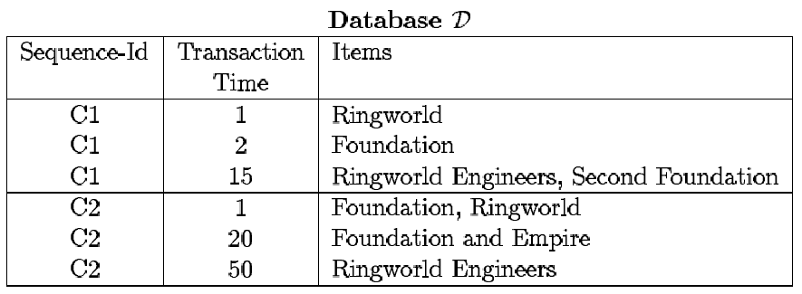
Input Database: example
45% of customers who bought Foundation will buy Foundation and Empire within the next month.

Slide 65
What Is Sequential Pattern Mining?
Given a set of sequences, find the complete set of frequent subsequences
A sequence : < (ef) (ab) (df) c b >
A sequence database
SID | sequence
10 | <a(abc)(ac)d(cf)>
20 | <(ad)c(bc)(ae)>
30 | <(ef)(ab)(df)cb>
40 | <eg(af)cbc>
An element may contain a set of items.
Items within an element are unordered
and we list them alphabetically.
<a(bc)dc> is a subsequence of <a(abc)(ac)d(cf)>
Given support threshold min_sup =2, <(ab)c> is a sequential pattern

Slide 66
A Basic Property of Sequential Patterns: Apriori
A basic property: Apriori (Agrawal & Sirkant’94)
  If a sequence S is not frequent
  Then none of the super-sequences of S is frequent
  E.g, <hb> is infrequent → so do <hab> and <(ah)b>
Seq. ID
Sequence
Given support threshold min_sup =2
10
<(bd)cb(ac)>
20
<(bf)(ce)b(fg)>
30
<(ah)(bf)abf>
40
<(be)(ce)d>
50
<a(bd)bcb(ade)>

Slide 67
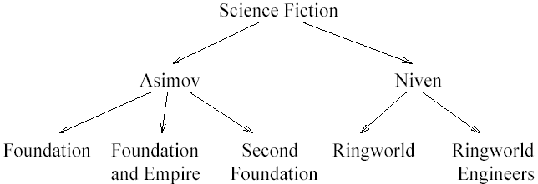
Generalized Sequences
Time constraint: max-gap and min-gap between adjacent elements
  Example: the interval between buying Foundation and Ringworld should be no longer than four weeks and no shorter than one week
Sliding window
  Relax the previous definition by allowing more than one transactions contribute to one sequence-element
  Example: a window of 7 days
User-defined Taxonomies: Directed Acyclic Graph
  Example:

Slide 68
GSP: Generalized Sequential Patterns
Input:
  Database D: data sequences
  Taxonomy T : a DAG, not a tree
  User-specified min-gap and max-gap time constraints
  A User-specified sliding window size
  A user-specified minimum support
Output:
  Generalized sequences with support >= a given minimum threshold

Slide 69
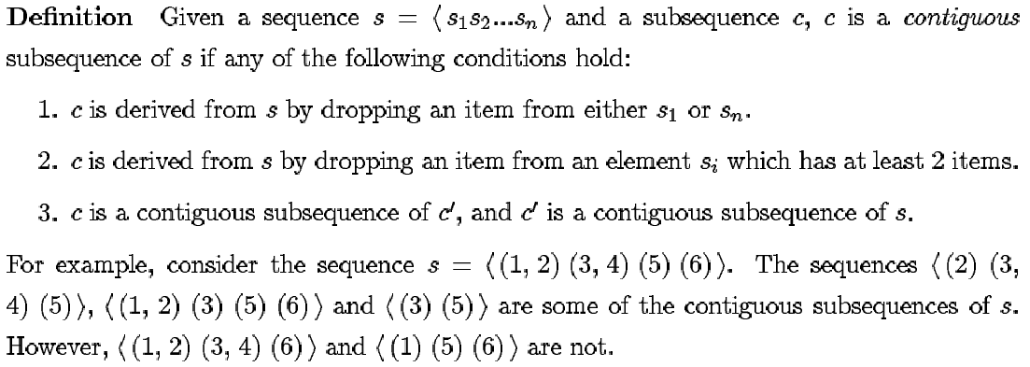
GSP: Anti-monotinicity
Anti-mononicity does not hold for every subsequence of a GSP
  Example: window = 7 days
    The sequence < Ringworld, Foundation, (Ringworld Engineers, Second Foundation) > is VALID while its subsequence < Ringworld, (Ringworld Engineers, Second Foundation) > is not VALID
Anti-monotonicity holds for contiguous subsequences

Slide 70
GSP: Algorithm
Phase 1:
  Scan over the database to identify all the frequent items, i.e., 1-element sequences
Phase 2:
  Iteratively scan over the database to discover all frequent sequences. Each iteration discovers all the sequences with the same length.
  In the iteration to generate all k-sequences
    Generate the set of all candidate k-sequences, C_{k}, by joining two (k-1)-sequences if only their first and last items are different
    Prune the candidate sequence if any of its k-1 contiguous subsequence is not frequent
    Scan over the database to determine the support of the remaining candidate sequences
  Terminate when no more frequent sequences can be found

Slide 71
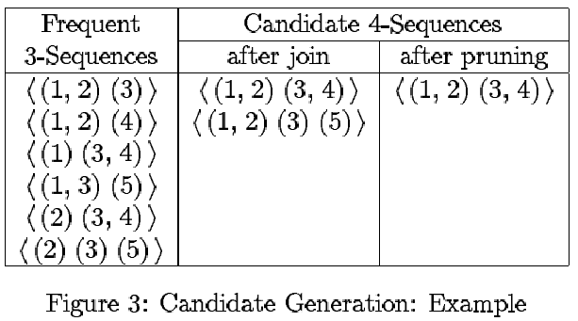
GSP: Candidate Generation
The sequence < (1,2) (3) (5) > is dropped in the pruning phase
since its contiguous subsequence < (1) (3) (5) > is not frequent.

Slide 72
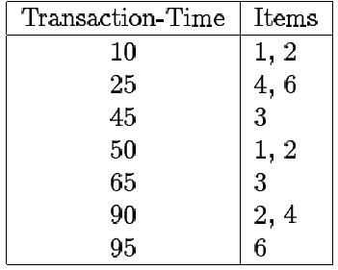
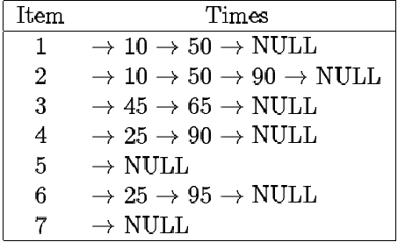
GSP: Optimization Techniques
Applied to phase 2: computation-intensive
Technique 1: the hash-tree data structure
  Used for counting candidates to reduce the number of candidates that need to be checked
    Leaf: a list of sequences
    Interior node: a hash table
Technique 2: data-representation transformation
  From horizontal format to vertical format

Slide 73
GSP: plus taxonomies
Naïve method: post-processing
Extended data-sequences
  Insert all the ancestors of an item to the original transaction
  Apply GSP
Redundant sequences
  A sequence is redundant if its actual support is close to its expected support

Slide 74
Example with GSP
Examine GSP using an example
Initial candidates: all singleton sequences
  <a>, <b>, <c>, <d>, <e>, <f>, <g>, <h>
Scan database once, count support for candidates
Cand | Sup
<a> | 3
<b> | 5
<c> | 4
<d> | 3
<e> | 3
<f> | 2
<g> | 1
<h> | 1
min_sup =2
Seq. ID
Sequence
10
<(bd)cb(ac)>
20
<(bf)(ce)b(fg)>
30
<(ah)(bf)abf>
40
<(be)(ce)d>
50
<a(bd)bcb(ade)>

Slide 75
Comparing Lattices (ARM vs. SRM)
 | <a> | <b> | <c> | <d> | <e> | <f>
<a> | <aa> | <ab> | <ac> | <ad> | <ae> | <af>
<b> | <ba> | <bb> | <bc> | <bd> | <be> | <bf>
<c> | <ca> | <cb> | <cc> | <cd> | <ce> | <cf>
<d> | <da> | <db> | <dc> | <dd> | <de> | <df>
<e> | <ea> | <eb> | <ec> | <ed> | <ee> | <ef>
<f> | <fa> | <fb> | <fc> | <fd> | <fe> | <ff>
51 length-2
Candidates
 | <a> | <b> | <c> | <d> | <e> | <f>
<a> |  | <(ab)> | <(ac)> | <(ad)> | <(ae)> | <(af)>
<b> |  |  | <(bc)> | <(bd)> | <(be)> | <(bf)>
<c> |  |  |  | <(cd)> | <(ce)> | <(cf)>
<d> |  |  |  |  | <(de)> | <(df)>
<e> |  |  |  |  |  | <(ef)>
<f>
Without Apriori property,
8*8+8*7/2=92 candidates
Apriori prunes
44.57% candidates

Slide 76
The GSP Mining Process
5th scan: 1 cand. 1 length-5 seq. pat.
<(bd)cba>
Cand. cannot pass sup. threshold
4th scan: 8 cand. 6 length-4 seq. pat.
<abba> <(bd)bc> …
Cand. not in DB at all
3rd scan: 46 cand. 19 length-3 seq. pat. 20 cand. not in DB at all
<abb> <aab> <aba> <baa> <bab> …
2nd scan: 51 cand. 19 length-2 seq. pat. 10 cand. not in DB at all
<aa> <ab> … <af> <ba> <bb> … <ff> <(ab)> … <(ef)>
1st scan: 8 cand. 6 length-1 seq. pat.
<a> <b> <c> <d> <e> <f> <g> <h>
Seq. ID
Sequence
min_sup =2
10
<(bd)cb(ac)>
20
<(bf)(ce)b(fg)>
30
<(ah)(bf)abf>
40
<(be)(ce)d>
50
<a(bd)bcb(ade)>

Slide 77
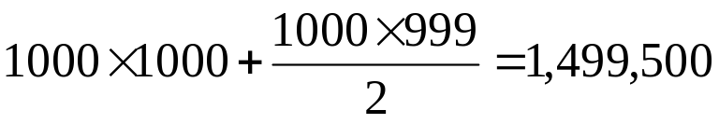
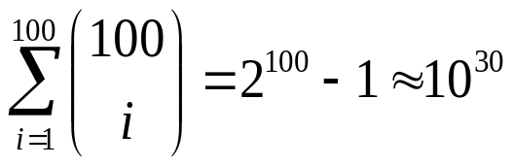
Bottlenecks of GSP
A huge set of candidates could be generated
  1,000 frequent length-1 sequences generate length-2 candidates!
Multiple scans of database in mining
Real challenge: mining long sequential patterns
  An exponential number of short candidates
  A length-100 sequential pattern needs 10³⁰ candidate sequences!

Slide 78
SPADE
Problems in the GSP Algorithm
  Multiple database scans
  Complex hash structures with poor locality
  Scale up linearly as the size of dataset increases
SPADE: Sequential PAttern Discovery using Equivalence classes
  Use a vertical id-list database
  Prefix-based equivalence classes
  Frequent sequences enumerated through simple temporal joins
  Lattice-theoretic approach to decompose search space
Advantages of SPADE
  3 scans over the database
  Potential for in-memory computation and parallelization

Slide 79
Recent studies: Mining Constrained Sequential patterns
Naïve method: constraints as a post-processing filter
  Inefficient: still has to find all patterns
How to push various constraints into the mining systematically?

Slide 80
Examples of Constraints
Item constraint
  Find web log patterns only about online-bookstores
Length constraint
  Find patterns having at least 20 items
Super pattern constraint
  Find super patterns of “PC → digital camera”
Aggregate constraint
  Find patterns that the average price of items is over $100

Slide 81
Characterizations of Constraints
SOUND FAMILIAR ? ☺
  Anti-monotonic constraint
  If a sequence satisfies C → so does its non-empty subsequences
  Examples: support of an itemset >= 5%
  Monotonic constraint
  If a sequence satisfies C → so does its super sequences
  Examples: len(s) >= 10
  Succinct constraint
  Patterns satisfying the constraint can be constructed systematically according to some rules
Others: the most challenging!!

Slide 82
Covered in Class Notes (not available in slide form
Scalable extensions to FPM algorithms
  Partition I/O
  Distributed (Parallel) Partition I/O
  Sampling-based ARM

